Slide 1
Tri Javascript Games
Eric Grant

Slide 2
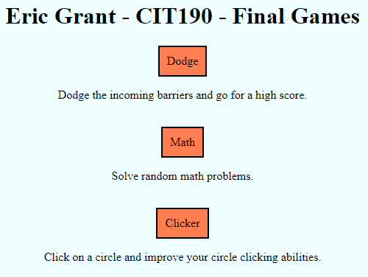
Ericgi231.me/cit190/final
My home page is very bare bones. It contains links to each game with some simple css and formatting.

Slide 3
Clicker
Click the circle in the center of the screen to increase your points.
Spend those points on upgrades to either increase the points gained per click or increase the points you gain automatically every set interval.
There is no way to win, the goal is to simply get your number as high as possible.

Slide 4
Demo
ericgi231.me/cit190/final/game3

Slide 5
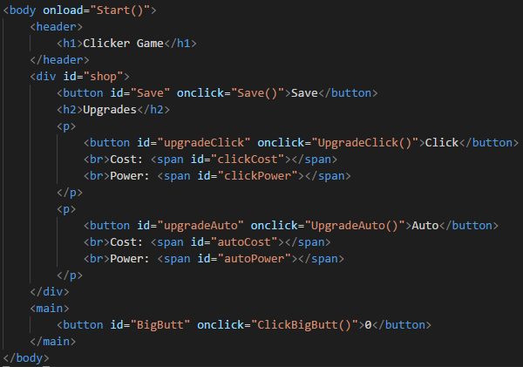

Slide 6

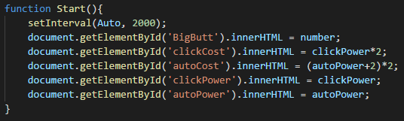

Slide 7

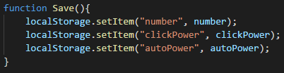

Slide 8
Math
Basic math problems appear at the top of the screen. Four answers appear below. One answer is correct, the others are false.
The goal is to solve the problems correctly to raise your score.
There is no win state, you continue to answer problems and achieve as high a score as possible.

Slide 9
Demo
ericgi231.me/cit190/final/game2

Slide 10
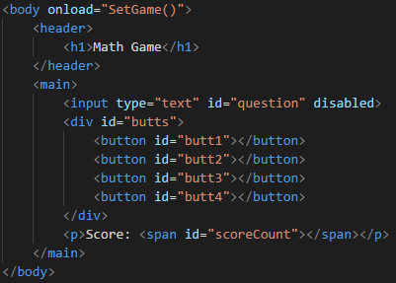

Slide 11

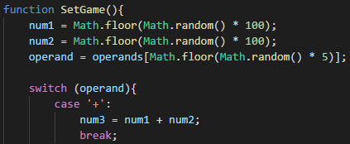

Slide 12
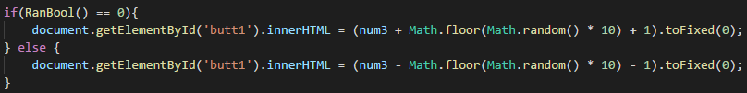

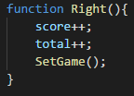


Slide 13
Dodge
Players use the left and right arrow keys to move a cube between set points along the bottom of the screen as to avoid incoming projectiles.
As you progress the game becomes more difficult.
After dodging 110 projectiles the difficulty maxes out and you have won the game. At this point the player is left to survive as long as they can.

Slide 14
Demo
ericgi231.me/cit190/final/game1

Slide 15
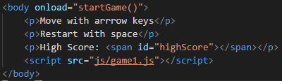
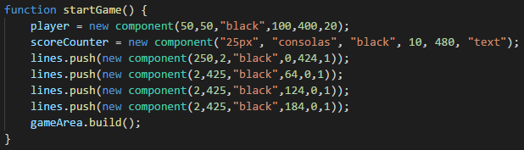

Slide 16
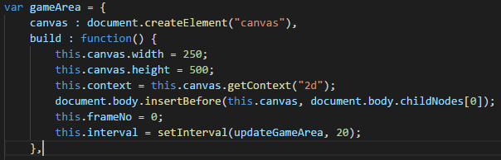
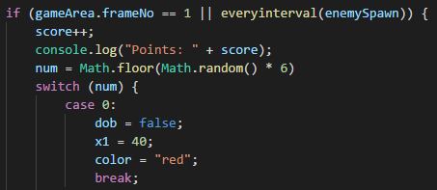

Slide 17

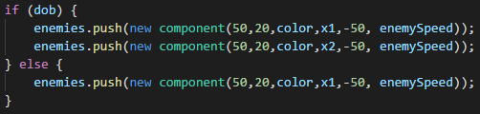

Slide 18
Design
For the Dodge game I decided to increase the difficulty by changing colors instead of speeds because changing speeds threw off a players muscle memory.
I used local storage instead of session so that scores stay saved passed one session.
Rounding numbers in Math game.

Slide 19
Problems
Impossible layouts in Dodge game.
Odd questions involving % in Math game.
Duplicate options in Math game.
Text going off the circle in Clicker game.

Slide 20
Improvements
More options in the clicker game.
More complex equations and better formatting in Math game.
Additional rows in Dodge game as well as more levels of difficulty.
Real winning conditions for each game.

Slide 21
What I Learned
Canvis
Local Storage
Almost proper classes in Javascript

Slide 22
Questions?

